Slide 1
Gradescope submission in 60 seconds

Slide 2
Gradescope advantages
For students:
Submit work from home
Read marks and feedback from home
Always have access to work and feedback
For us:
Never lose any work
Record marks automatically
Divide questions between markers easily

Slide 3
Gradescope disadvantages
For students:
Submission process a bit of a palaver
For us:
More student excuses for late work
Poor quality scans are difficult to read
Some students submit photos, not proper scans

Slide 4
Submission process
1. Scan in work with a scanning app
2. Save scanned work to phone’s file system or to shared folder
3. Send scanned work from phone to laptop
4. Log on to Minerva on laptop,
then find and follow link to Gradescope
5. Find scanned work on laptop
6. Upload scanned work to Gradescope

Slide 5
Submission process
33% Microsoft Lens
32% photos with camera app 😬
12% Adobe Scan
10% CamScanner 😬😬😬
4% Genius Scan
4% Notes app
6% other
1. Scan in work with a scanning app
2. Save scanned work to phone’s file system or to shared folder
3. Send scanned work from phone to laptop
4. Log on to Minerva on laptop,
then find and follow link to Gradescope
5. Find scanned work on laptop
6. Upload scanned work to Gradescope

Slide 6
Submission process
33% Microsoft Lens
32% photos with camera app 😬
12% Adobe Scan
10% CamScanner 😬😬😬
4% Genius Scan
4% Notes app
6% other
1. Scan in work with a scanning app
2. Save scanned work to phone’s file system or to shared folder
3. Send scanned work from phone to laptop
4. Log on to Minerva on laptop,
then find and follow link to Gradescope
5. Find scanned work on laptop
6. Upload scanned work to Gradescope
36% Wireless (eg. AirDrop)
30% Email
30% OneDrive (or other shared folder)
4% WhatsApp (or other chat app)
2% USB cable

Slide 7
Submission process
33% Microsoft Lens
32% photos with camera app 😬
12% Adobe Scan
10% CamScanner 😬😬😬
4% Genius Scan
4% Notes app
6% other
1. Scan in work with a scanning app
2. Save scanned work to phone’s file system or to shared folder
3. Send scanned work from phone to laptop
4. Log on to Minerva on laptop,
then find and follow link to Gradescope
5. Find scanned work on laptop
6. Upload scanned work to Gradescope
36% Wireless (eg. AirDrop)
30% Email
30% OneDrive (or other shared folder)
4% WhatsApp (or other chat app)
2% USB cable
83% Access Gradescope via laptop
17% Access Gradescope via phone

Slide 8
Submission process
1. Scan in work with a scanning app
2. Save scanned work to phone’s file system or to shared folder
3. Send scanned work from phone to laptop
4. Log on to Minerva on laptop,
then find and follow link to Gradescope
5. Find scanned work on laptop
6. Upload scanned work to Gradescope

Slide 9
Submission process
1. Scan in work with a scanning app
2. Save scanned work to phone’s file system or to shared folder
3. Send scanned work from phone to laptop
4. Log on to Minerva on laptop,
then find and follow link to Gradescope
5. Find scanned work on laptop
6. Upload scanned work to Gradescope
or
…just use the
Gradescope app

Slide 10
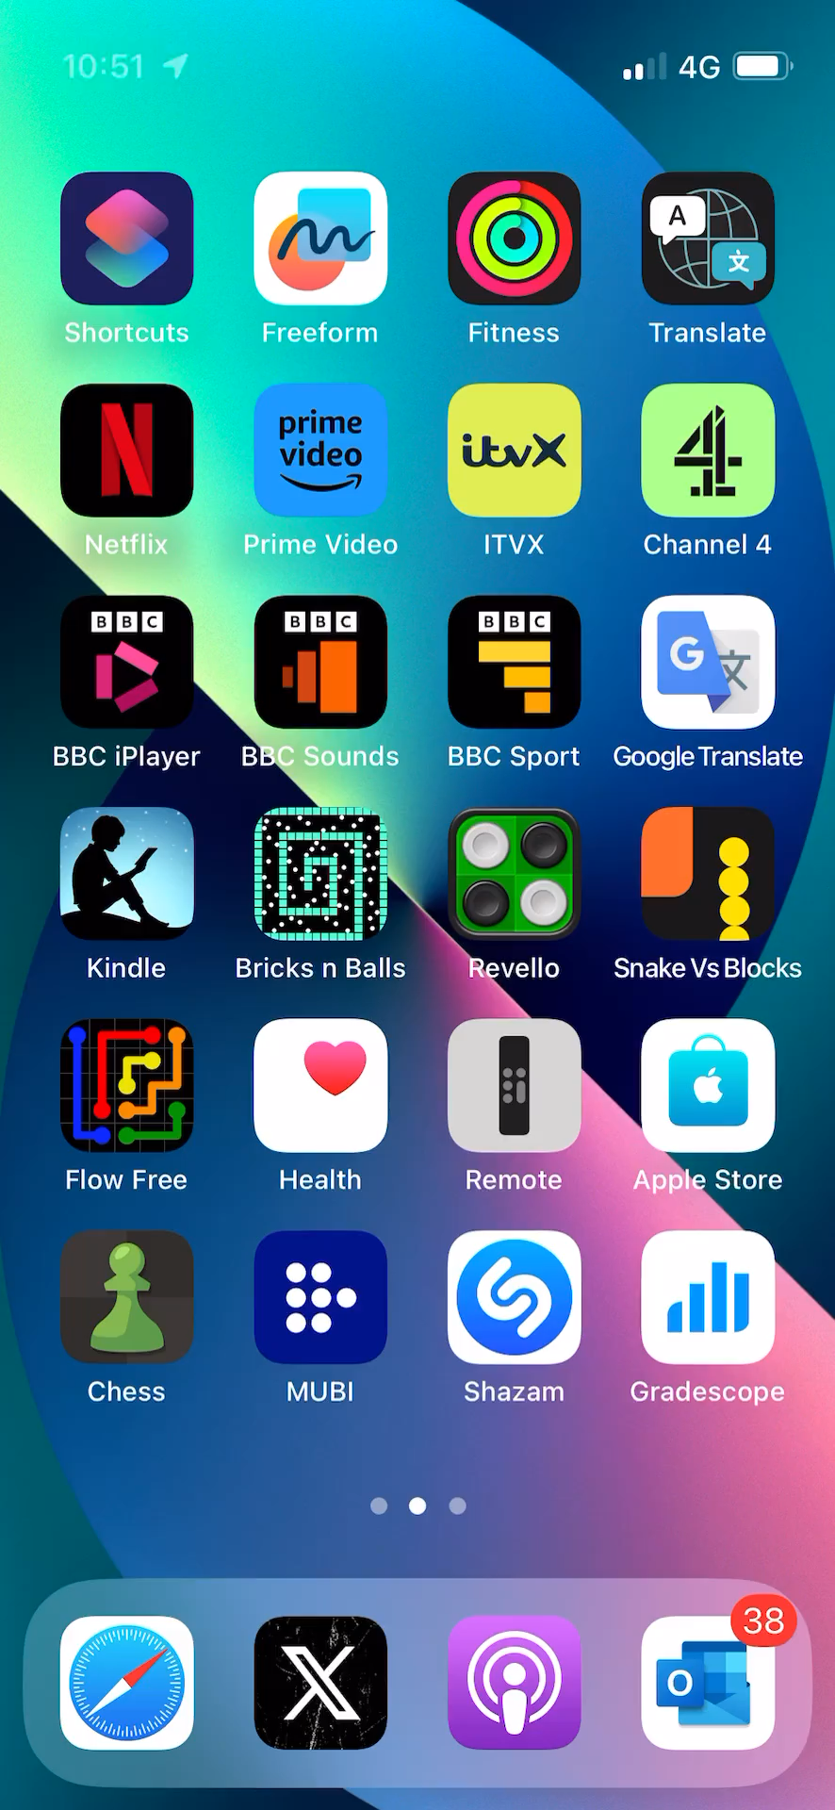
https://youtu.be/VntgvJimbvc

Slide 11
A second-year module
(not encouraged to use the app)
My first-year module
(encouraged to use the app)
82% | Gradescope website, via laptop
14% | Gradescope website, via phone
5% | Gradescope app
59% | Gradescope website, via laptop
15% | Gradescope website, via phone
27% | Gradescope app

Slide 12
The Gradescope app is…
…is the easiest and quickest way for students to submit handwritten work
…the best way for us to ensure we get high-quality, clearly scanned submissions
…how we should be encouraging students to submit work

